Slide 1
1.01
Acquire information about the sport/event industry to aid in making career choices

Slide 2

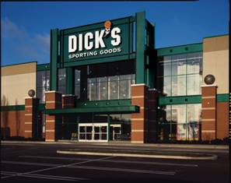

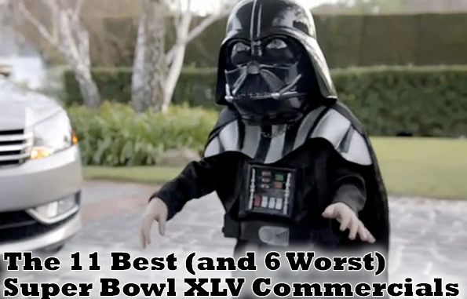
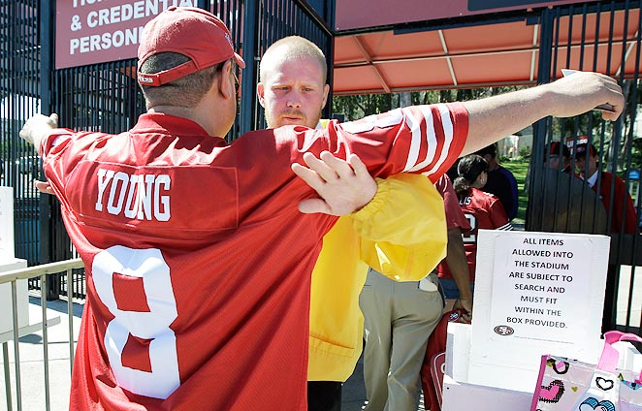
Types of Businesses in SEM
  Franchises
  Security
  Advertising
  Sporting Goods
  Media
Notes:
Kaser, K. & Oelkers, D.B., (2001). Sports and entertainment marketing [pp. 9,
14-17, 18-22]. Mason, OH: South-Western

Slide 3
Variety of Sports Available
  Professional Teams
  Professional Individual Sports
  Collegiate/Scholastic Teams
  Venues: Coliseums, Arenas, Speedways
  Health Clubs
  Recreation
  Camps

Slide 4




Professional Teams
  Basketball: Charlotte Hornets
  Football: Carolina Panthers
  Hockey: Carolina Hurricanes
  Baseball: Winston-Salem Dash

Slide 5
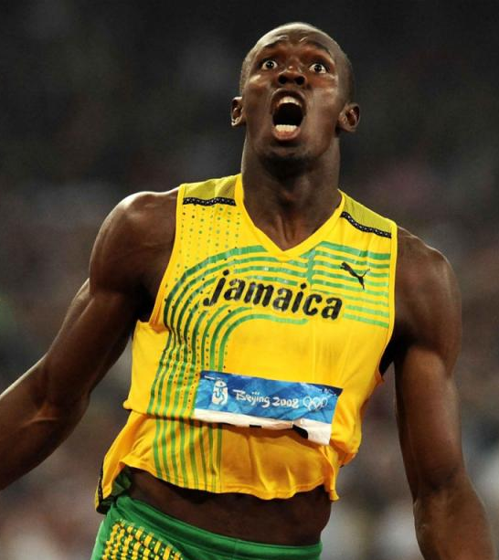
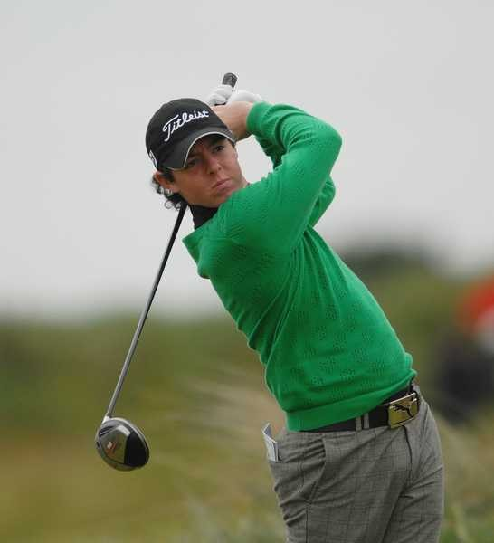
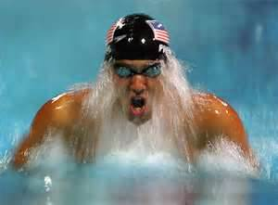
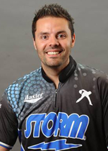
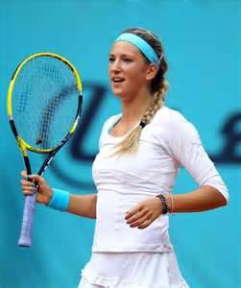
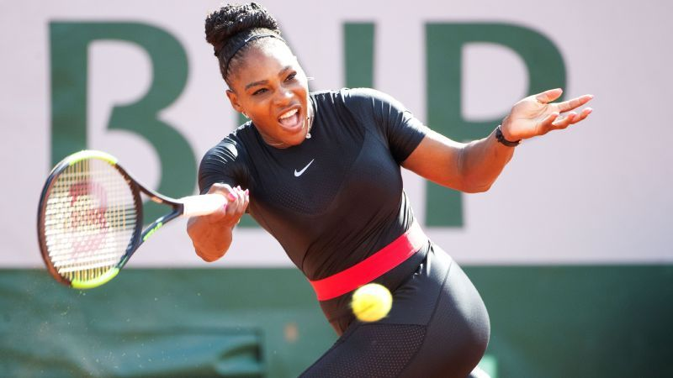
Professional Individual Sports
  Running
  Swimming
  PGA
  WTA
  PBA

Slide 6
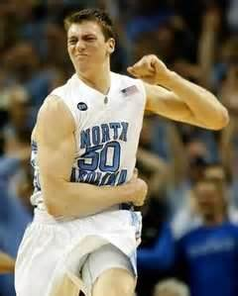
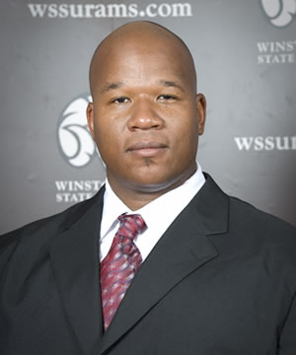
Collegiate and Scholastic Teams
  University of North Carolina
  WSSU

Slide 7
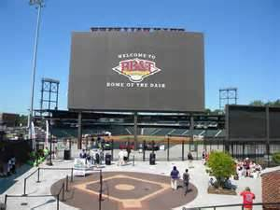
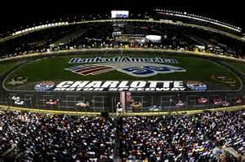
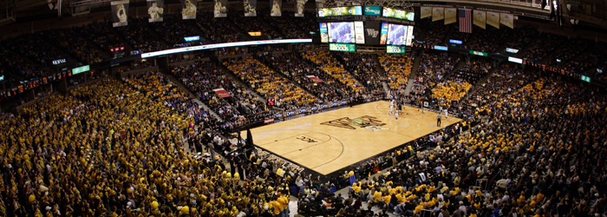
Venues: Arenas, Stadiums, Coliseums, Speedways
  Lawrence Joel Veteran’s Coliseum
  Charlotte Motor Speedway
  BB&T Baseball Stadium

Slide 8



Health Clubs
  Gold’s Gym
  YMCA
  Curves

Slide 9
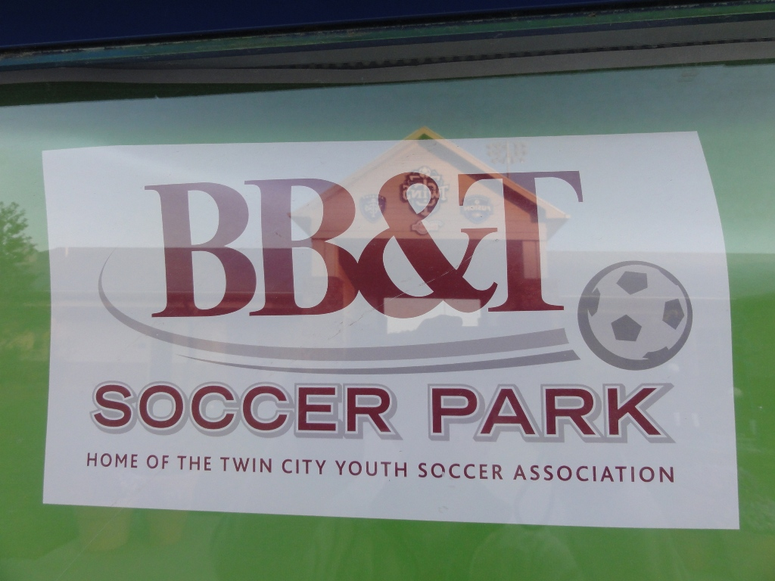
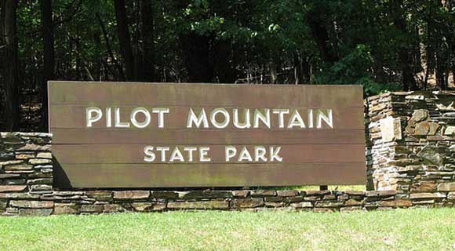
Recreation
  Aerobics
  Soccer
  Basketball
  Swimming
  Area parks

Slide 10
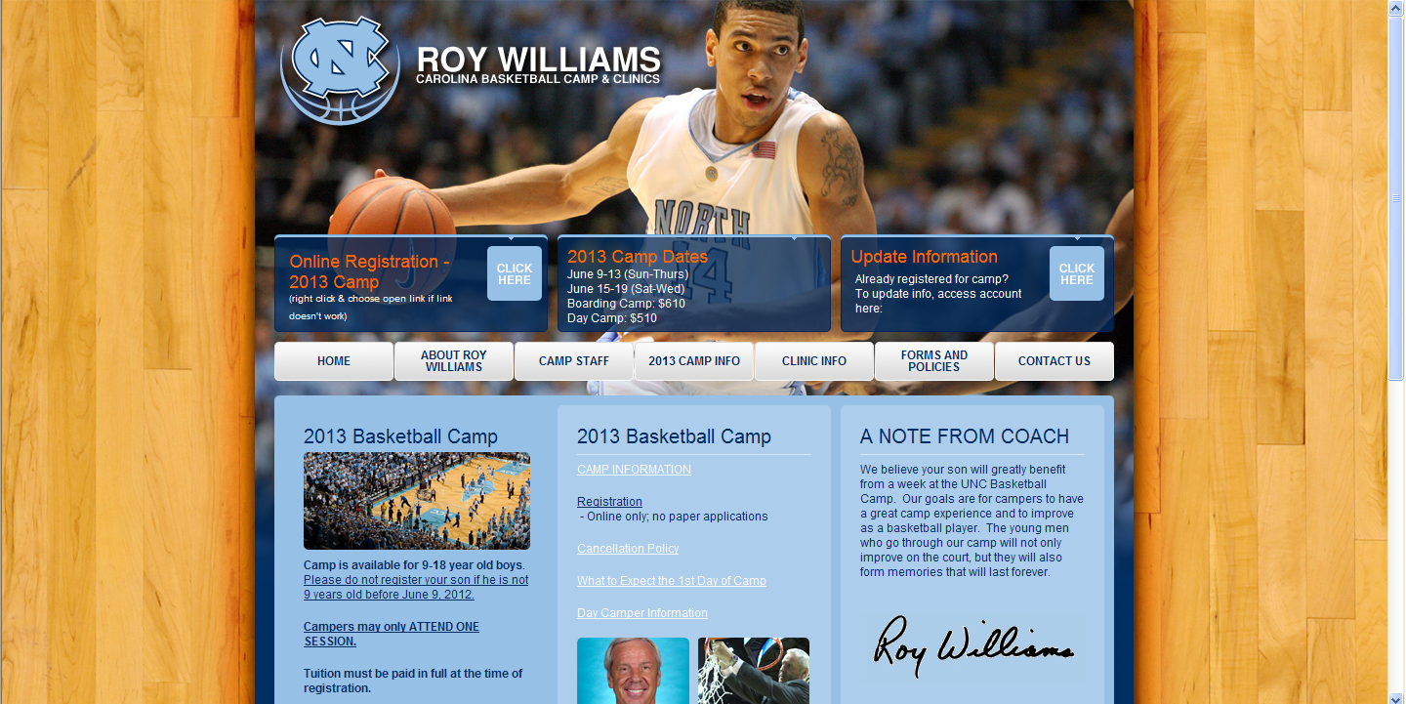
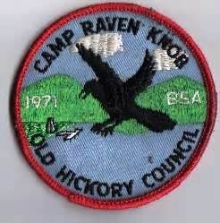
Camps
  Tennis Camp
  Basketball Camp
  Soccer Camp
  Raven Knob

Slide 11
Variety of Entertainment/Events Available
  Music
  Movies
  Theme Parks
  Radio
  Television
  Dramatic Arts
  Video Games
  Literacy Industry
  Gambling Industry

Slide 12
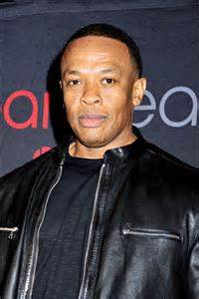


Music Industry
  Record Labels (Big Four)
  Artists
  Producers

Slide 13



Movie Industry
  Studios
  Cast
  Crew

Slide 14
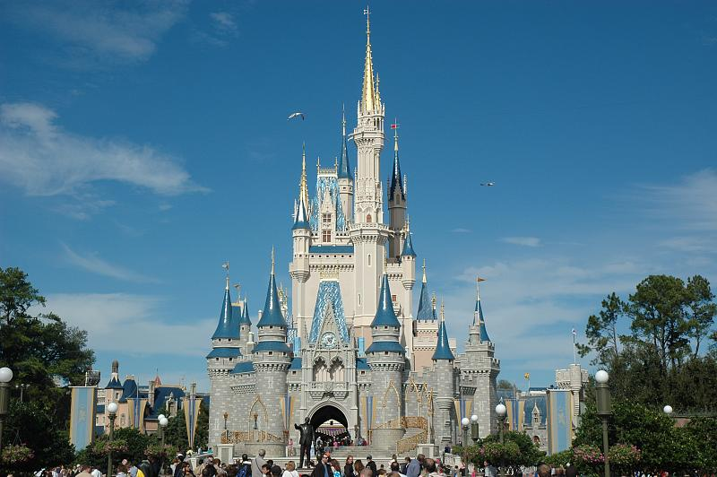
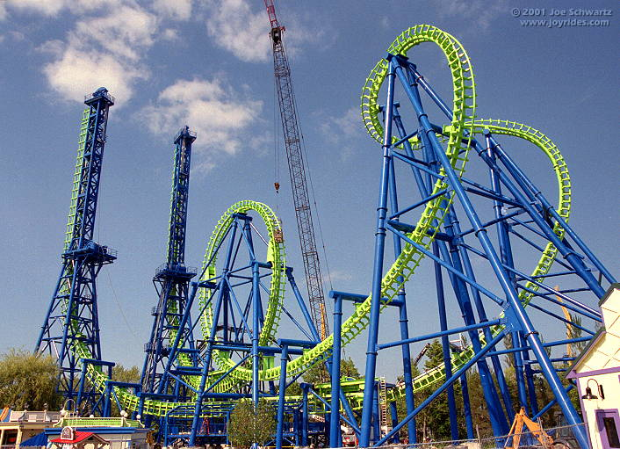
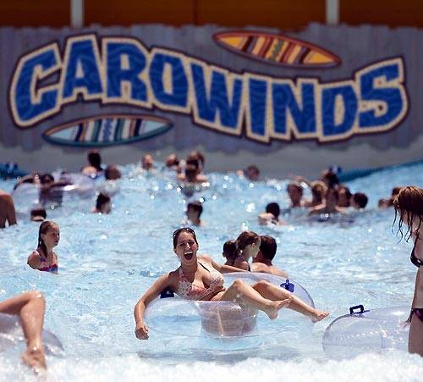
Theme Parks
  Disney World
  Six Flags
  Carowinds

Slide 15



Radio Industry
  AM/FM stations
  SiriusXM satellite radio
  Syndicated radio networks

Slide 16




Television Industry
  Broadcast networks
  Cable networks
  Cable/satellite television
  Syndicated shows

Slide 17
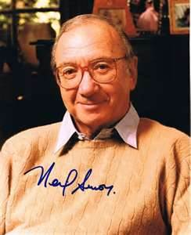
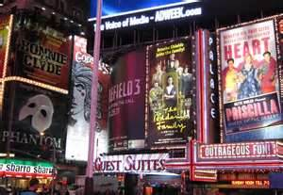

Dramatic Arts Industry
  Playwrights
  Theaters
  Festivals

Slide 18

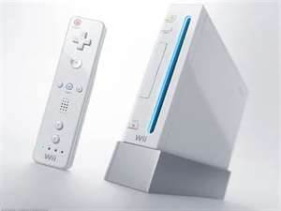
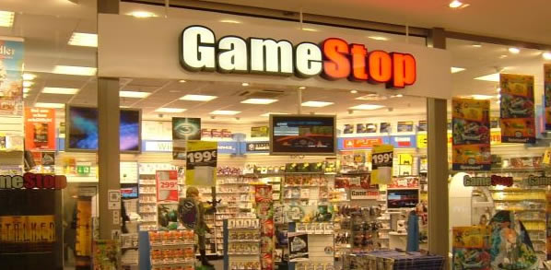
Video Game Industry
  Consoles
  Games
  Retailers

Slide 19


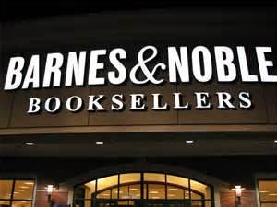
Literacy Industry
  Publishers
  Authors
  Retailers

Slide 20
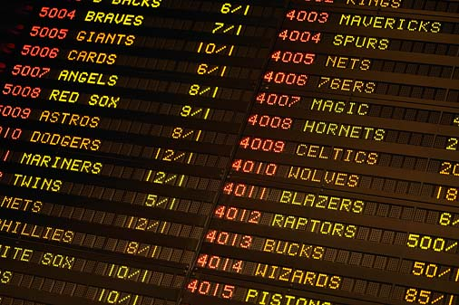
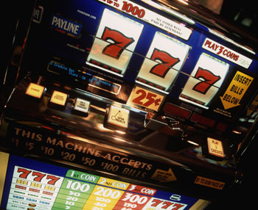
Gambling Industry
  Casinos
  Sports betting

Slide 21
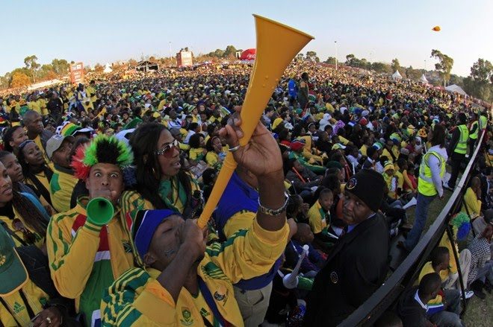

Factors Contributing to the Growth of SEM
  Increase of participants in sports/entertainment
  Increase of followers of sports/entertainment
  Increase in attendance in sports/entertainment
  Increase of media coverage
  Internationalization
Notes:
Lindauer, Chris. "History and Evolution of SEM." sportscareerconsulting.com. Sports Career Consulting, 17 Dec 2005. Web. 20 Aug 2010. <http://www.sportscareerconsulting.com/request.php?772>.

Slide 22
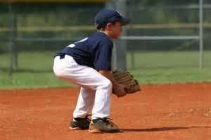
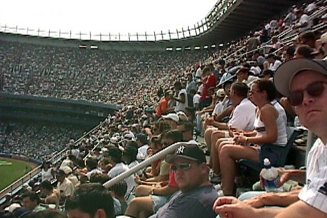
Characteristics of the SEM Industry
Provides products that are different for each consumer
Seeks markets that include spectators and participants

Slide 23

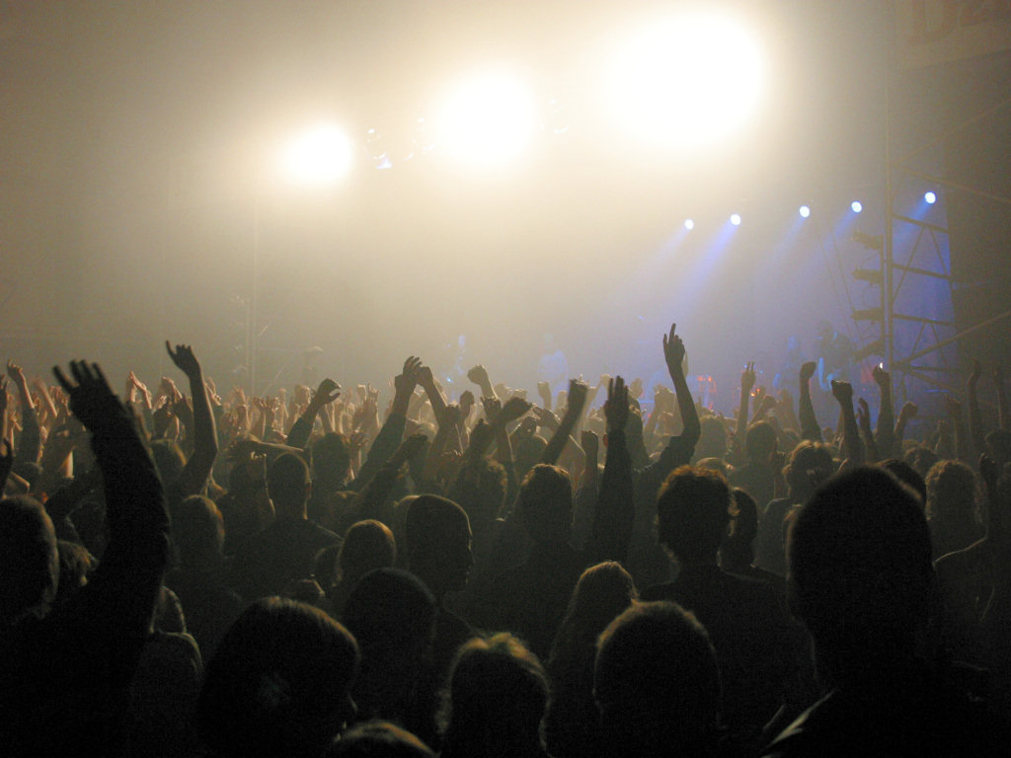

Core Benefits of SEM
Entertainment
Health
Achievement

Slide 24
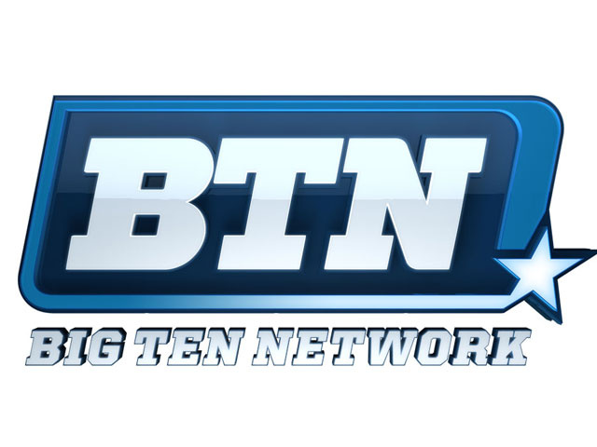

Trends in Sports & Entertainment
  Sports:
    Naming rights
    Sport specific channels
  Entertainment:
    Internet webcasts
    Event marketing

Slide 25
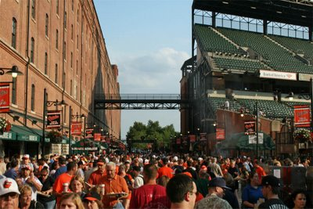
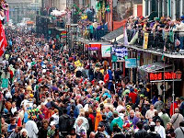
SEM Contributes to Economic Well-Being of Communities
  Increased job creation
  Increased consumer spending
  Attract tourist dollars
  Fiscal impact: contribute to tax base
Notes:
Kaser, K. & Oelkers, D.B. (2001). Sports and entertainment marketing
[pp. 30, 36-37]. Mason, OH: South-Western.
Kern, W.S. (2000). The economics of sports [chapter 1]. Retrieved Aug 23, 2010 from http://www.upjohninst.org/publications/ch1/kern-sports.pdf
Pic: http://de.academic.ru/pictures/dewiki/67/CamdenYards_2005-05-08.jpg

Slide 26


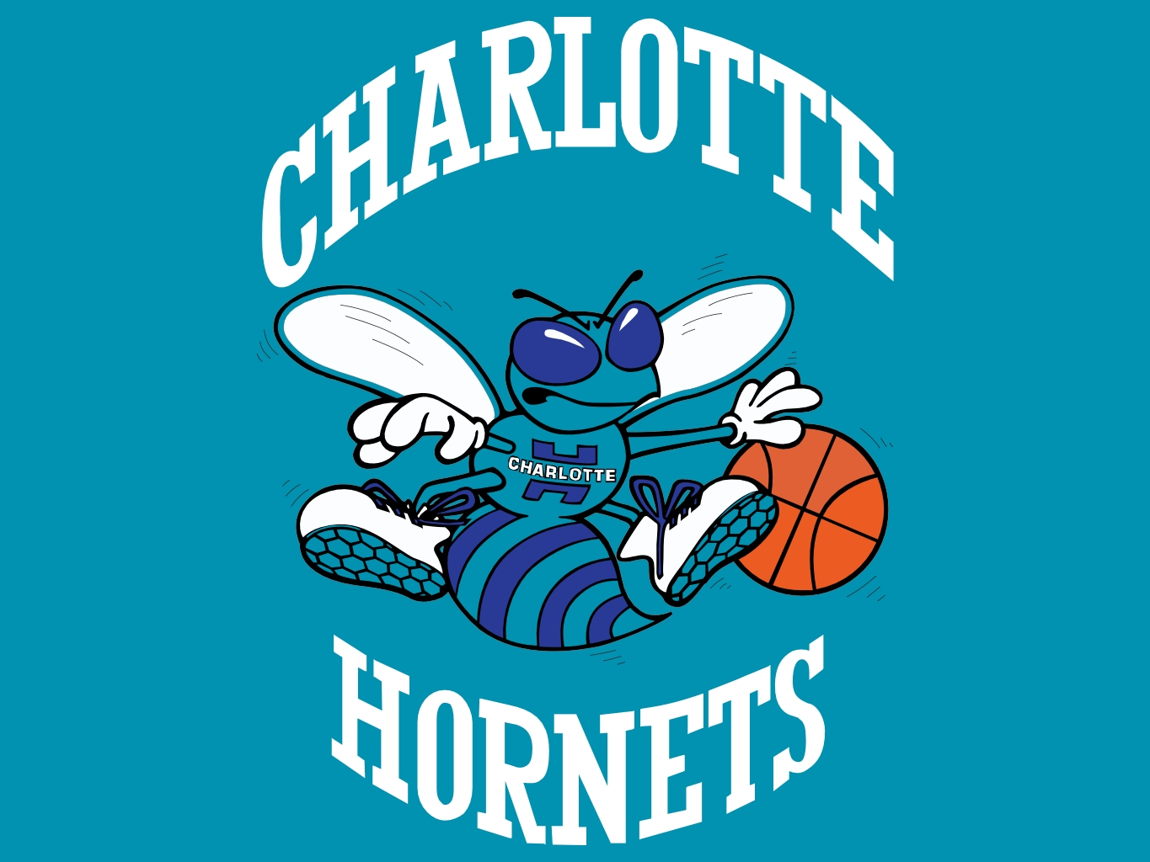

Negative Impacts of SEM on Community
  Questionable impact on tax revenue
  Divert resources from other priorities (education, roads, public safety)
  Community can be "held hostage" by a team
Notes:
http://www.chriscreamer.com/images/logos/6/256/full/3097.gif

Slide 27
How Communities Can Minimize Negative Impact of Hosting an Event
  Sign teams to long-term stadium leases
  Diversify-host more than one sport
  Host multiple events in stadium/arena
  Notify the community in advance
  Provide necessary security/traffic resources

